Slide 1
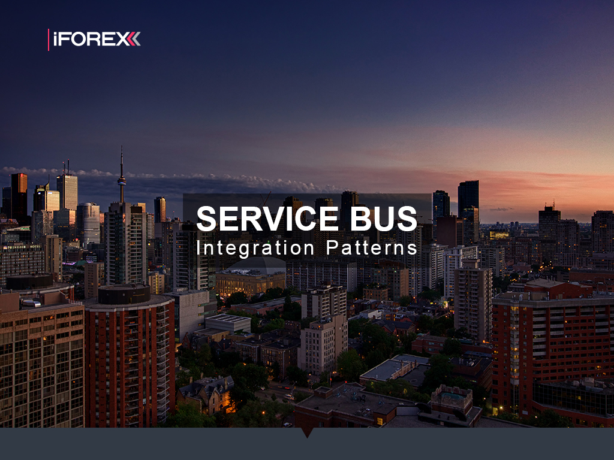
Alex Michel
iFOREX
Silviu Eigel
NESS

Slide 2
Solution
Code
Mass Transit
Mass Transit Stack
Patterns
Transports
Scale-Out
Integrations
Architecture
Availability
Legacy System
Architecture
Problems
More
Explore
Read
Hack

Slide 3
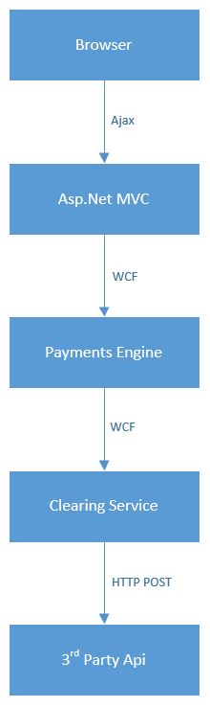
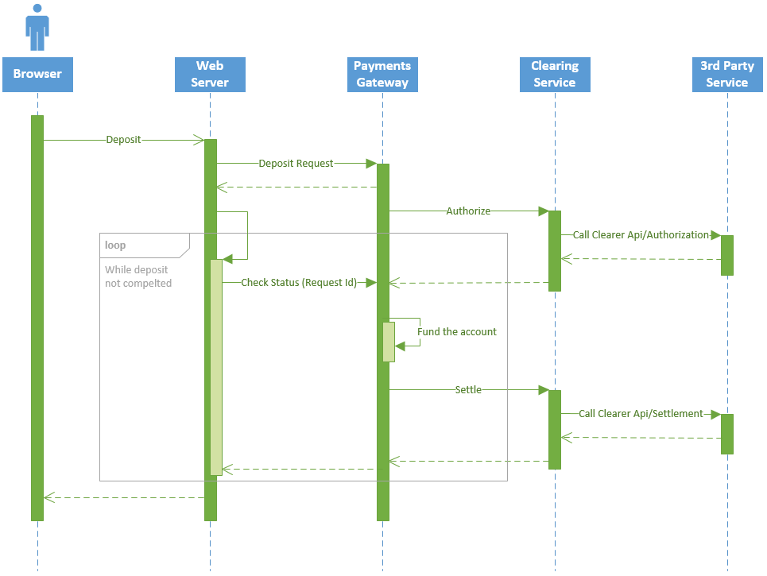
Legacy System Architecture

Slide 4
Legacy System Problems
Not Scalable
Hard to split into independent functional parts
Impossible to scale out core components
Parallelism and flow control through explicit low-level thread scheduling and synchronization
No Resiliency
Single point of failure
No means of automatic failover
Waste of Resources
Synchronous Requests
Active Connections
Busy Waiting
Background Threads
Tight Coupling
Strict Imperative Flow Control Code
Components interact via interfaces/abstract classes signatures

Slide 5

MassTransit
MassTransit is a free, open-source service bus and distributed application framework for .NET
Infrastructure
Configuration
Flow Control
Correlation
Messaging Patterns
Request/Respond
Other
Testing Library
Transports
Encryption
Lifetime
Serialization
Retry Policy
Scheduling
Dead Letter
Circuit Breaker
Pipes and Filters
Monitoring
Persistency
Routing
Publish/Subscribe
Saga and Saga State Machine
Routing Slip
Error Handling
Composite Events
Transforms
Versioning
Transforms
Compensations

Slide 9
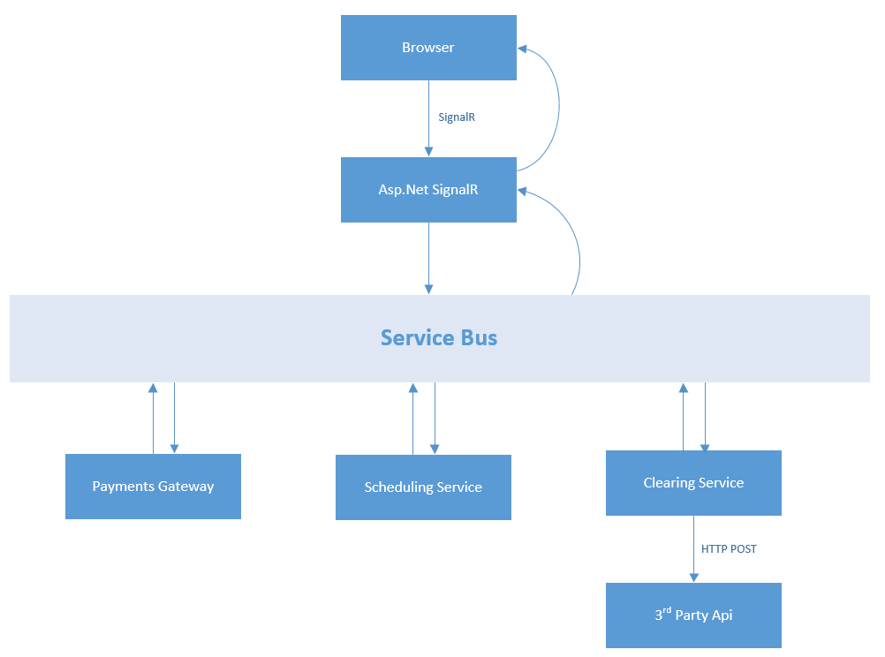
Solution Architecture

Slide 10
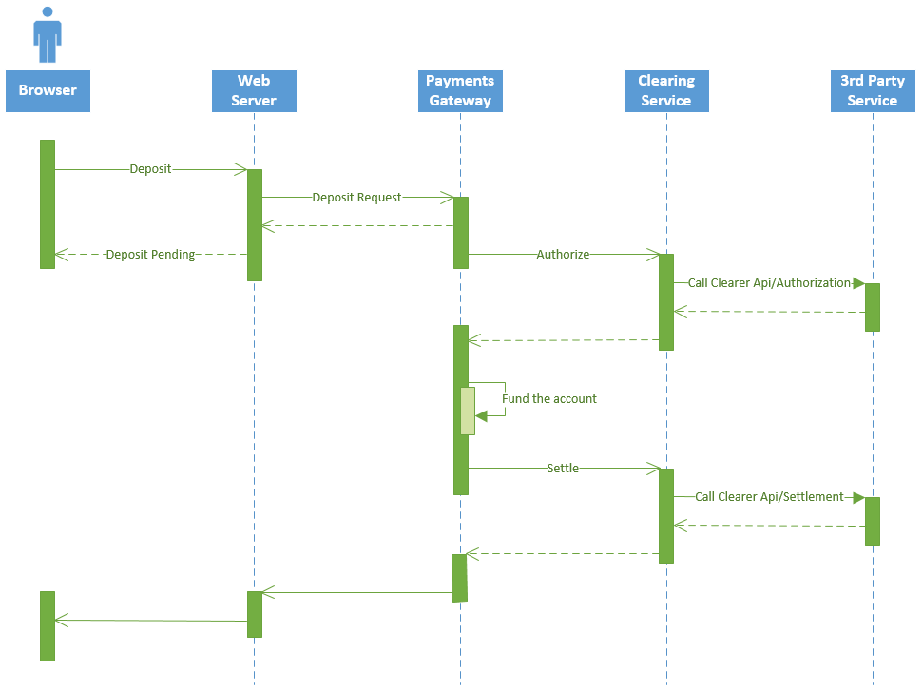
Solution Architecture

Slide 11
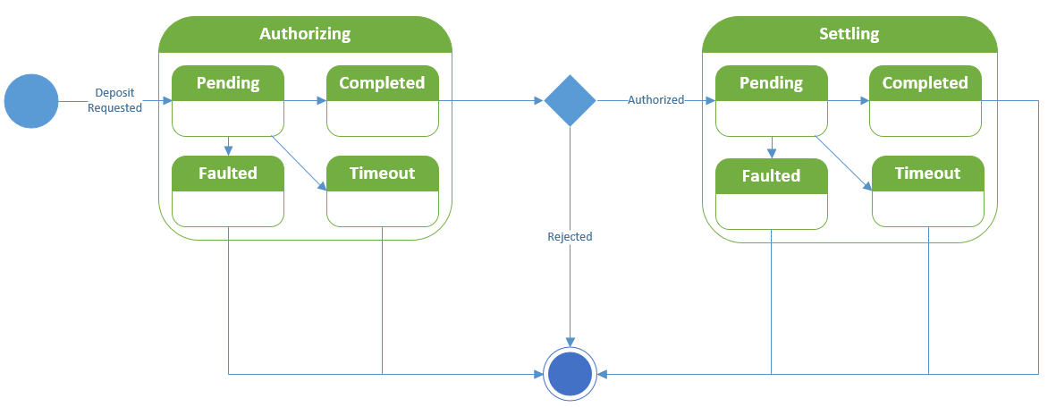
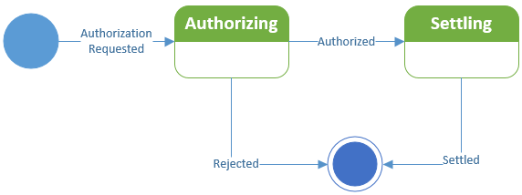
Solution Architecture

Slide 12
Demo – at last!

Slide 13
Not Covered in Demo
Persistency
Compensations
Versioning
Configuration Management
RabbitMQ and Azure SB
Community Middleware
Many Other…

Slide 14
Wait a Minute! You promised:
Scalability
Resiliency
Cloud Support

Slide 15
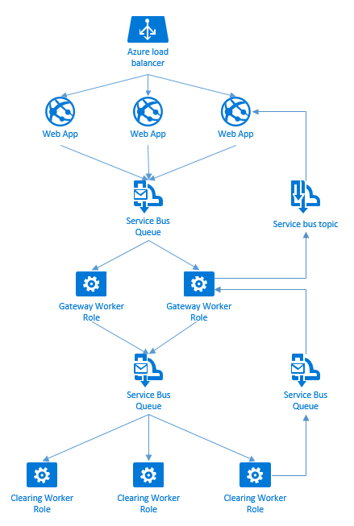
Cloud Deployment
Deploy and scale out in Azure
Scale frontend with load balancer
Use Azure Service Bus as Transport
Scale backend with Competing Consumers and PubSub
Use metrics for auto-scaling policy (e.g. receiving queue size)

Slide 17
Read
https://media.readthedocs.org/pdf/masstransit/latest/masstransit.pdf
https://msdn.microsoft.com/en-us/library/dn600223.aspx

